Slide 1
CryoVEx 2014 CryoSat-2 validation validation experiment
Rene Forsberg / Sine M. Hvidegaard
Dept. of Geodynamics, DTU-Space
rf@space.dtu.dk / smh@space.dtu.dk

Slide 2
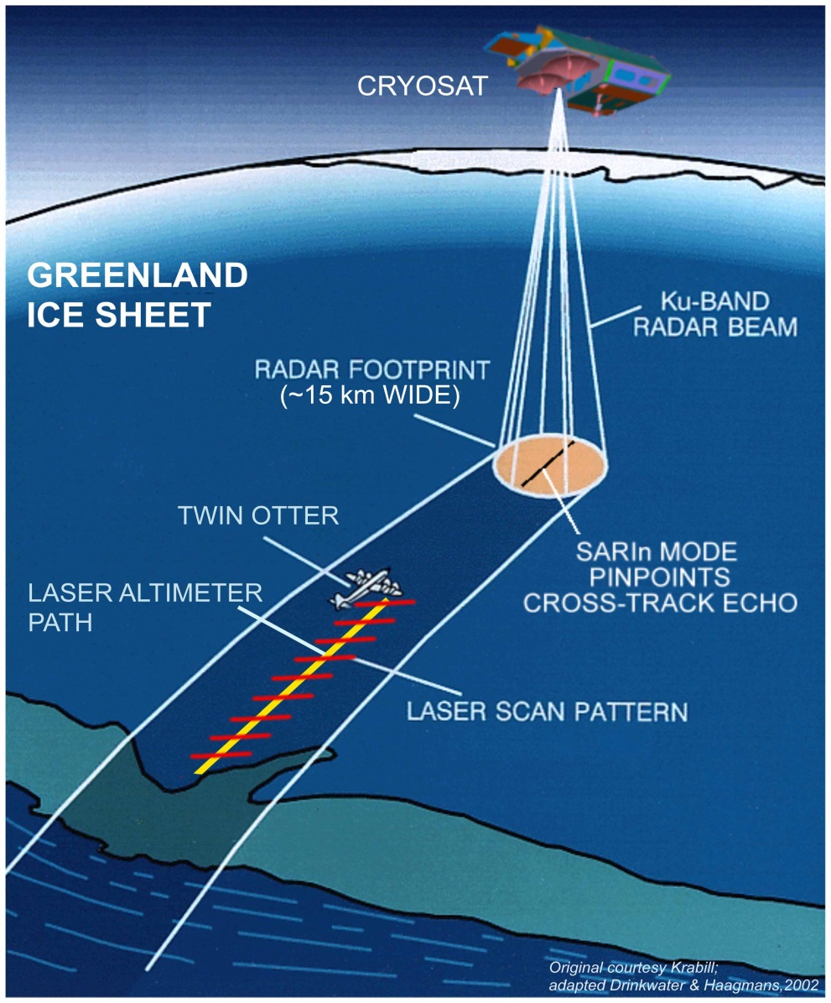
Airborne Validation Campaigns by DTU Space
...2006-2008-2011-2012 ...
Lidar measurements … Riegl Q240i scanner
Ku-Band radar … ESA ASIRAS
Nadir imagery
Coincident flights for ice thickness (EM-bird)
Coincident flights with Op. IceBridge
In-situ ground teams: - Land ice: Austfonna, Devon, EGIG line (-2012)
- Sea ice: Alert
AIMS:
Validate observations - techniques
Improved knowledge of relevant parameters
Study seasonal changes and natural variability

Slide 3
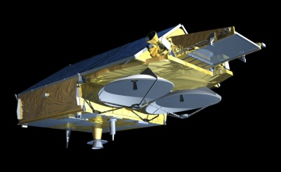
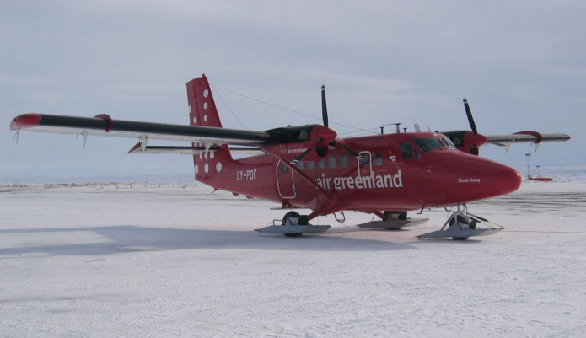
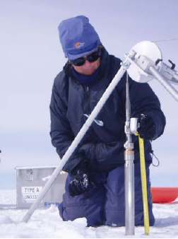
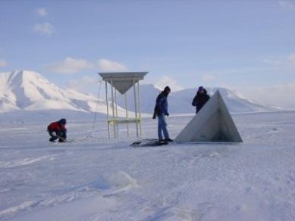
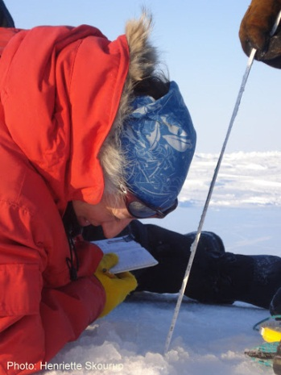
CryoVEx campaigns
Global
Regional
Local
Notes:
Involves various partners from Europe, Canada and US ... And demands ... Planning and logistics to

Slide 4
CryoVEx 2011 and 2012
2011 spring
Flight hours:102
# CryoSat-2
Ground tracks: 7
2012 spring
Flight hours:112
# CryoSat-2
Ground tracks: 16
Notes:
Validation sites represent different CryoSat modes:
EGIG line LRM
Austfonna/Devon SARIn
Sea ice Alert/RV Lance ... SAR

Slide 5
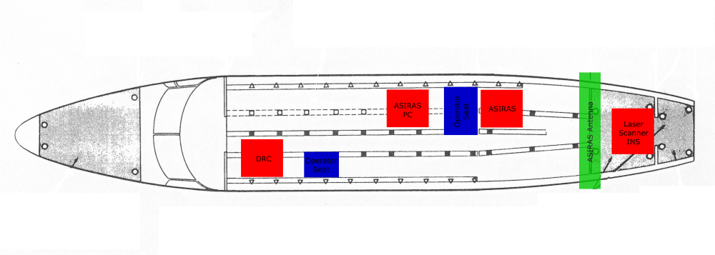
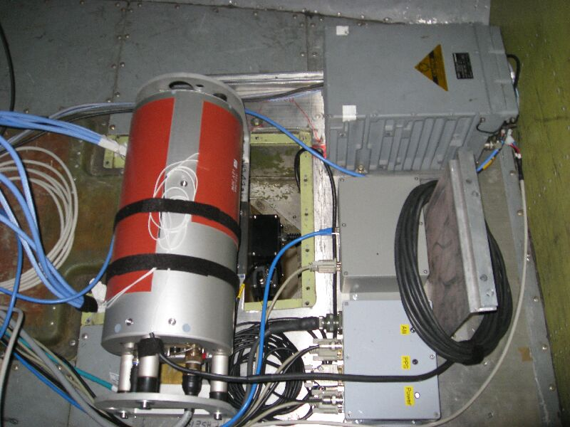
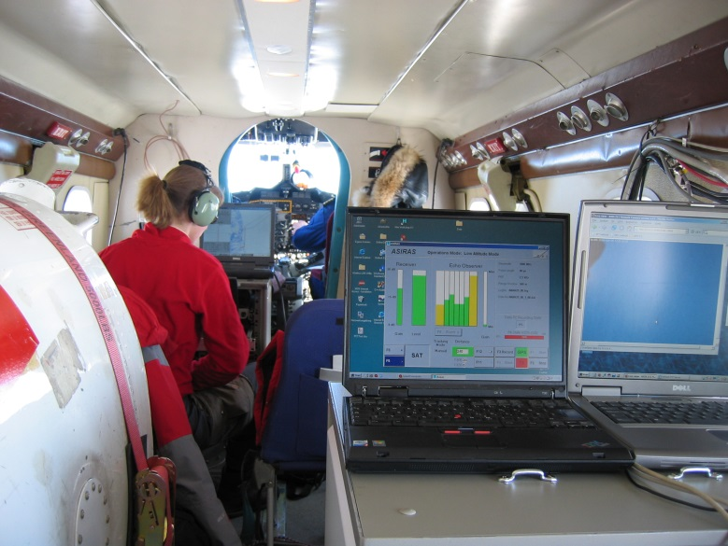
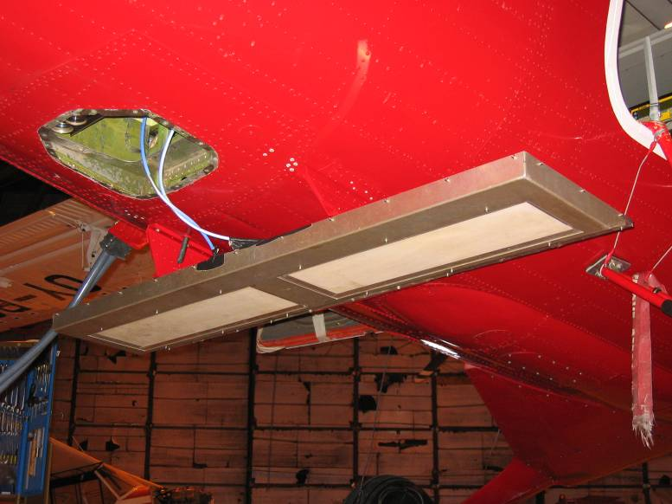
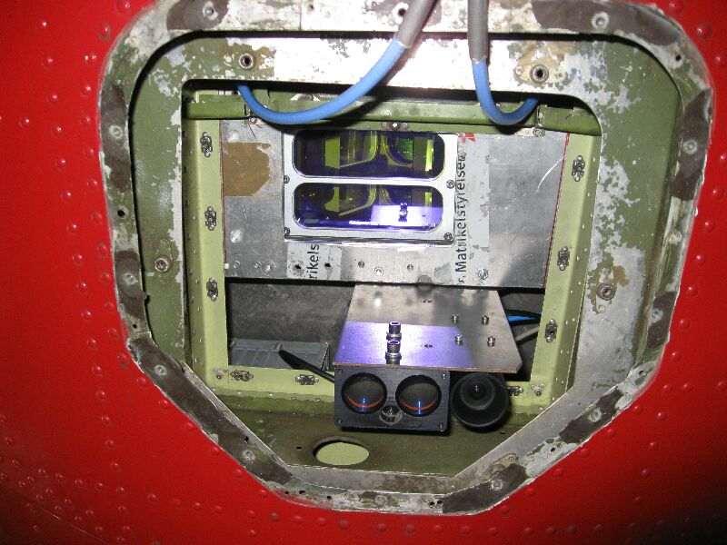
Installation

Slide 6
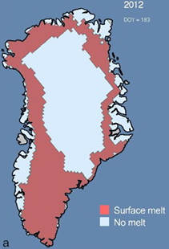
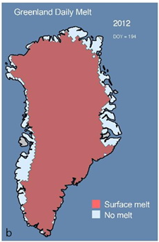
CryoVex 2014: Science goals
Sea ice:
Primary:
Ice camps N of Alert and Beaufort Sea (C Haas / M Cornelissen)
Secondary:
Baffin Bay: Thin FY ice overflights in connection
with ice camp/Devon transits
Fram Strait: Flights in connection with transfers;
overflight of RV Lance (drifting station)
Land ice:
EGIG line, Greenland: GPR, neutron sonde profiles
(repeat of 2011 survey)
- Special science need: impact of 2012 summer melt event
- Additional effort from NorthGrip camp or in far north?
- Corner reflectors
Devon Ice Cap: GPR, GPS, coffee can experiments, snow pits
- Denser flights requested (fuel in place at camp)
- Corner reflectors
Austfonna: GPR, GPS, shallow cores, accumulation
- Corner reflectors
Greenland 2012 melt event

Slide 7
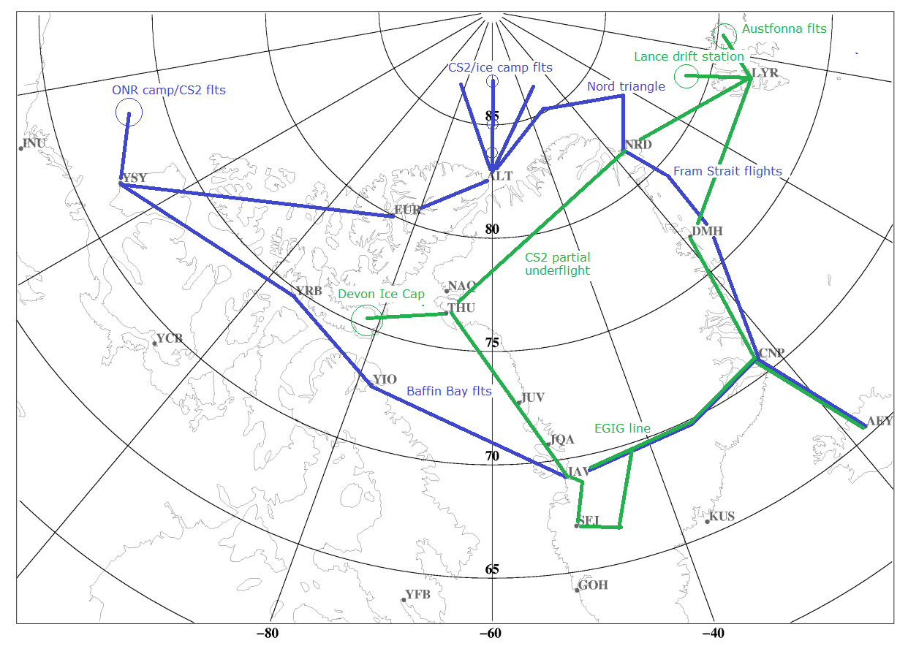
Twin-Otter flights (sea ice and land ice)

Slide 8
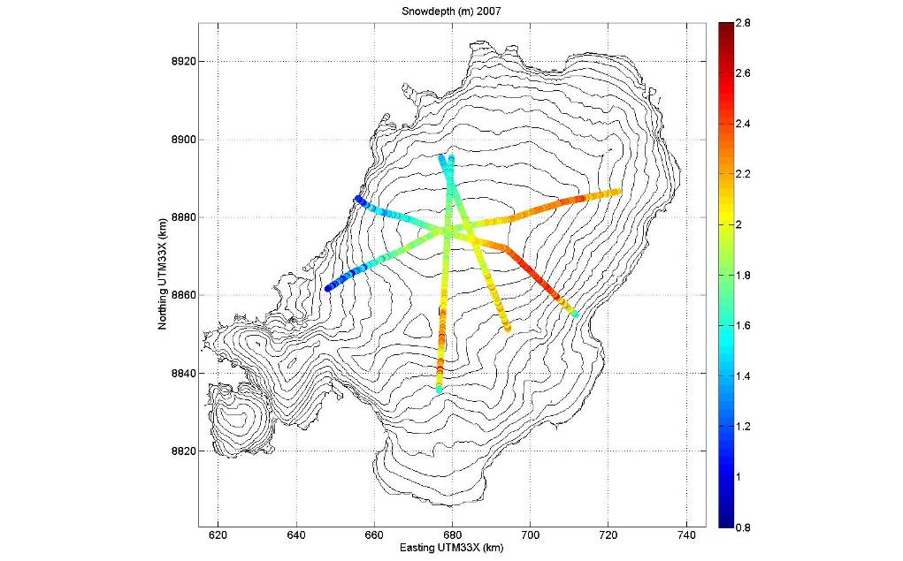
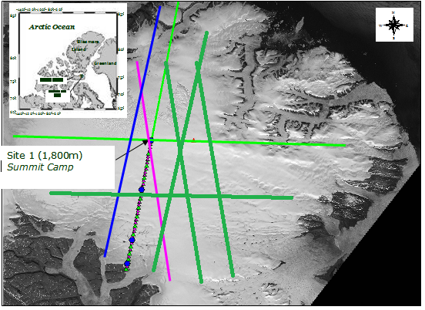
Time schedule - draft
17-20 MAR | Installation / transit measurements
21-22 MAR | ONR ice camp flights
24-25 MAR | Transit to Alert
26-31 MAR | Alert Sea ice flights (-weekend)
1-2 APR | Station Nord / Fram Strait flights
3 APR | Unmount, Akureyri (+ spare day)
22-24 APR | Reinstallation / transit Fram Strait
25-28 APR | Svalbard flights (Austfonna / Lance)
29 APR | Transit Thule via Nord
30 APR-1 MAY | Devon ice cap, refuel at camp (skis)
2-3 MAY | Transit to JAV, EGIG CS2 flights
5-6 MAY | Return to AEY, unmount
Austfonna GPR lines
Devon Ice Cap – more CS and crosslines
(fuel and landing conditions permitting)

